Slide 1
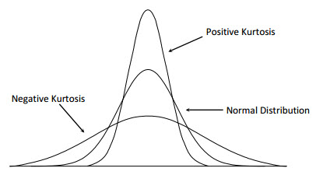
Kurtosis
excess kurtosis describes the tail shape of the data distribution:
mesokurtic: The normal distribution has 0 excess kurtosis and thus the standard tail shape.
Platykurtic: Negative excess kurtosis would indicate a thin-tailed data distribution, histogram is not bell-shaped.)

Slide 2
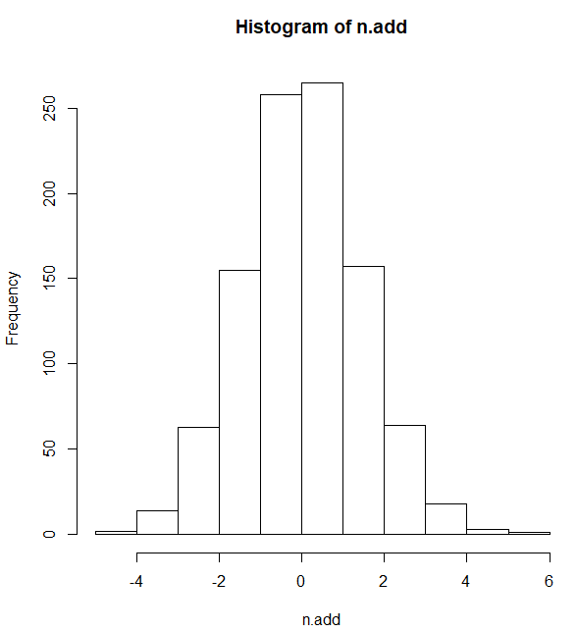
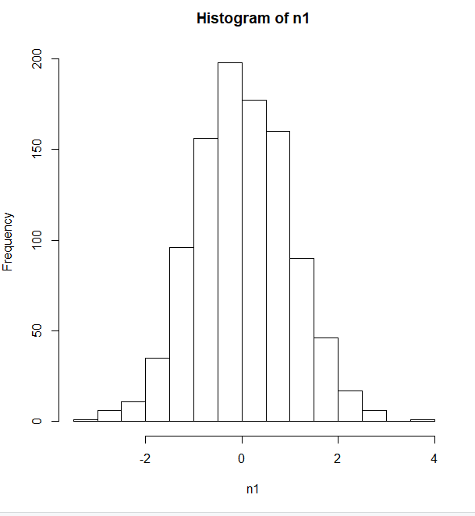
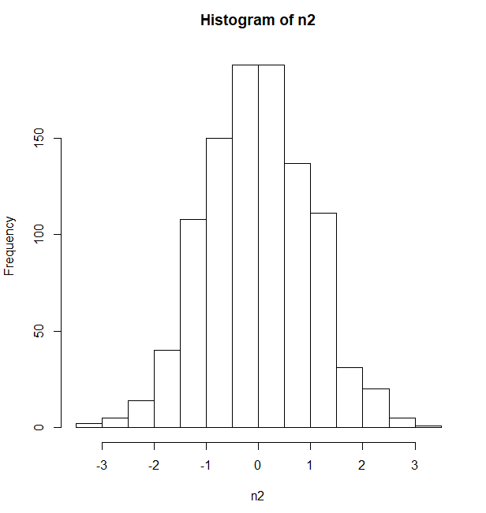
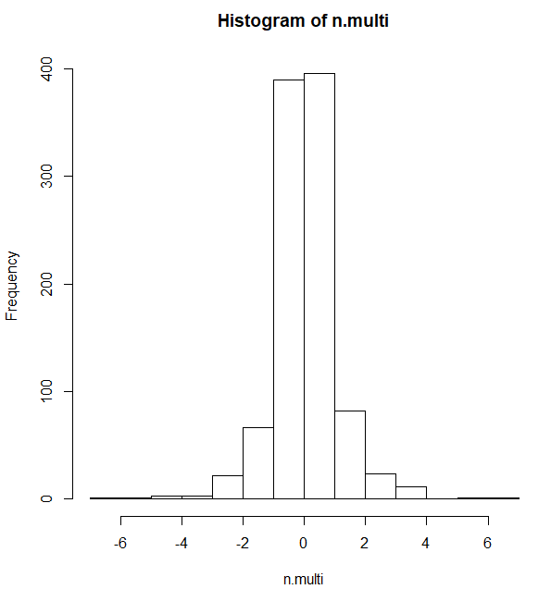
n1 <- rnorm(1000)
n2 <- rnorm(1000)
n1
n2
n1+n2
N1*n2
mesokurtic
Platykurtic
mesokurtic
Kurtosi= 0.01640296
Kurtosi=-0.05659611
Kurtosi=0.0736724
Kurtosi=7.29572

Slide 3

